Slide 1

PLAYSTORE ANALYSIS
Presented By:
Yasser Mohammed Kaoor

Slide 2
1
Introduction
2
Design
OBJECTIVES
3
Data
4
Algorithms
5
Tools

Slide 3
INTRODUCTION
- APP - Rating - Category - Size - Installs - Genres - Reviews - Type - Price - Target
What will be our next App?

Slide 4
DESIGN
Does category affect the number of installs?
What is the category with the highest number of installs?
Is the category with the highest number of installs also has the highest average in installs?
Does Rating have a role in increasing the number of downloads?
Does the price affect the number of downloads?
Does Targets have a role in increasing the number of downloads?

Slide 5
DATA
Description
Cleaning Data
Data source
Rows = 10840.
Columns = 10.
Nulls in Rating = 1474
Duplicates = 1181
Total rows after drop 9659
A- Rename columns
B- Remove duplicated Apps
C- Fill non rated rows by mean
D- Change columns types
Kaggle:
https://www.kaggle.com/madhav000/playstore-analysis/version/1

Slide 6
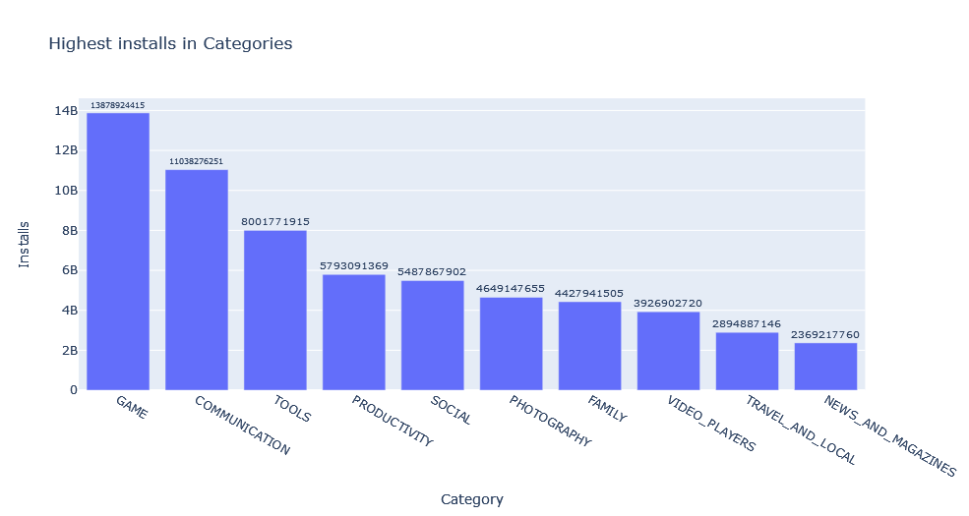
CATEGORY AND INSTALLS

Slide 7
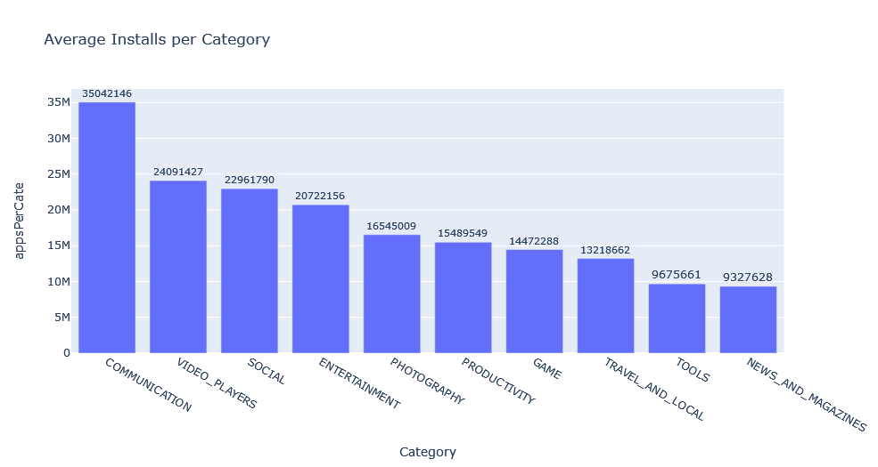
CATEGORY AND INSTALLS

Slide 8
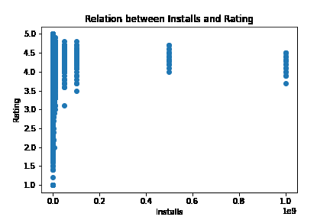
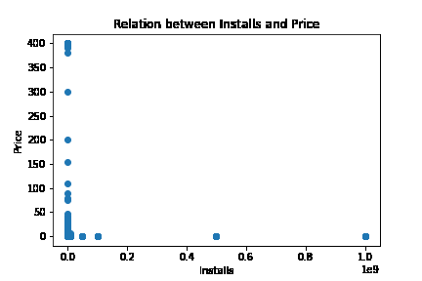
RELATIONS

Slide 9
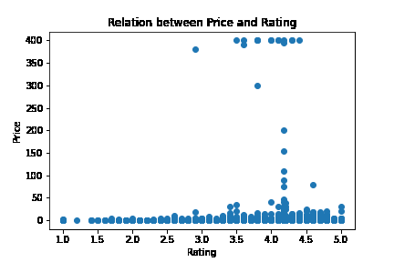
RELATIONS

Slide 10
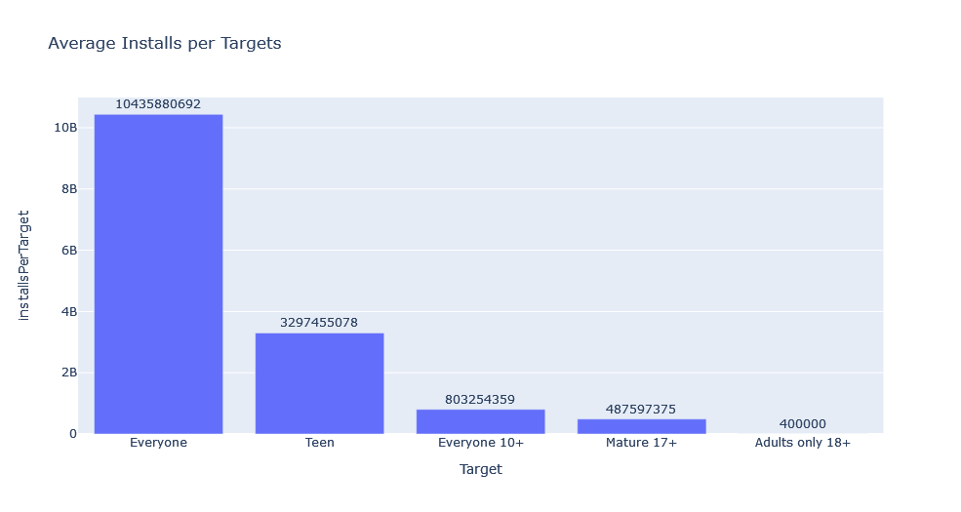
TARGETS

Slide 11
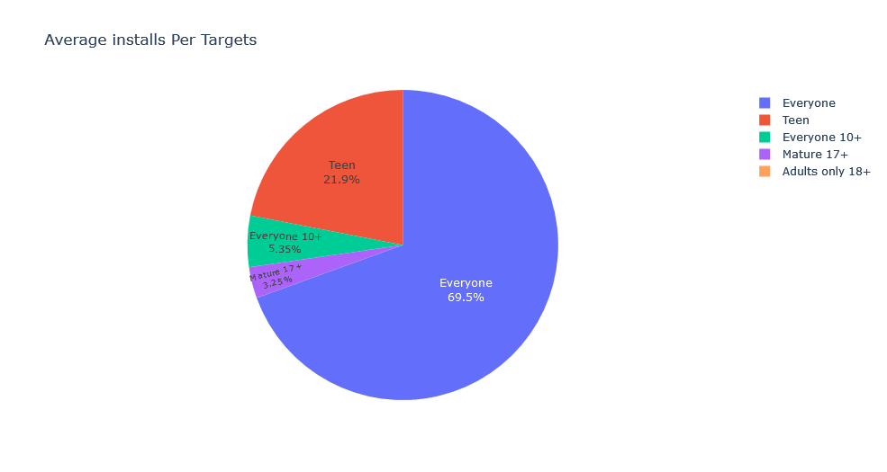
TARGETS

Slide 12
CONCLUSIONS
01
02
03
Category
Price
Targets
1- Communication
2- Video Player
3- Social
Paid or not Paid
Everyone

Slide 13
TOOLS
Jupyter Notebook
Language: Python
Libraries: numpy, pandas, seaborn
Presentation: Canva

Slide 14
ANY QUESTION?

